Slide 1
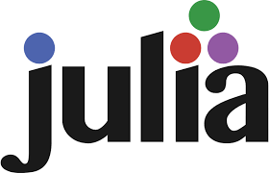
Julia: A Programming Language
By: Christian Tuttle

Slide 2
Purpose:
Scientific Computing, Data Science, Machine Learning, Numerical Analysis
Designed for high performance, compiled in LLVM
Fast as C, easy as Python
Functional/Procedural
Scientific tooling is often written in Julia
Created by MIT in 2012 by Jeff Bezanson, Stefan Karpinski, Viral B. Shah.

Slide 3
Core Syntax
Easy to read
General Purpose Language
Clean Mathematical Syntax, Good for Equations
# A simple Julia function showing core syntax
function demo_julia(n)
arr = [] # create an empty array
sum_sq = 0 # variable for sum of squares
for i in 1:n # loop from 1 to n
push!(arr, i^2) # append square of i to array
sum_sq += i^2 # accumulate sum
end
message = "Sum of squares from 1 to $n is $sum_sq"
println("Array of squares: ", arr)
println(message)
return sum_sq
end
demo_julia(5)

Slide 4
Other interesting things
Parallelism built in
Multiple Dispatch (multiple version of same function)
No Class based inheritance, no method overriding, not "everything is an object"
Thousands of packages and libraries (not as big as python)
NASA, BlackRock, ASML have all used Julia for modeling, data analytics, simulations, etc

Slide 5


Julia VS Python
Initially Python was beating Julia in speed when working with video game sales data (ex: py – 0.05s, ju – 0.08s)
When using math (Monte Carlo pi simulation)
  Python – 4.69 seconds
  Julia – 0.14 seconds
Great at Math!

Slide 6
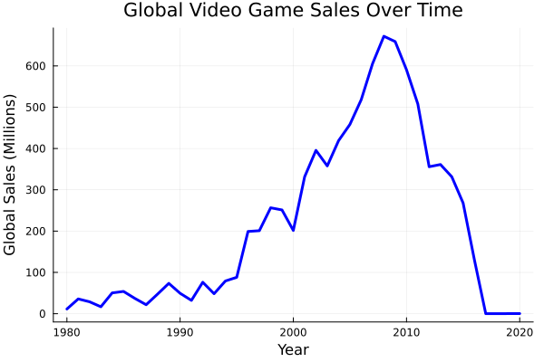
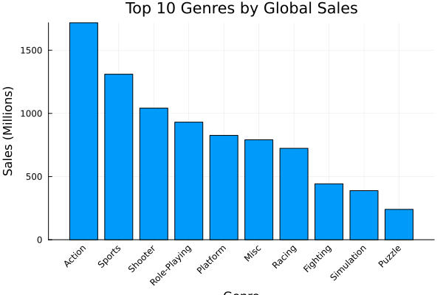
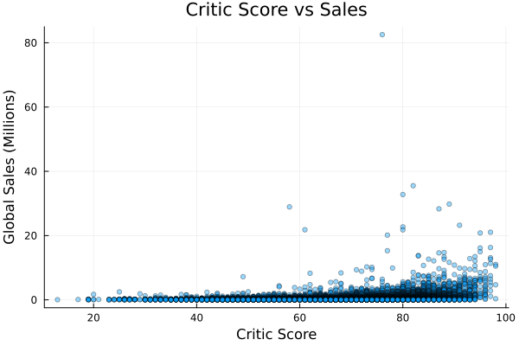
Working With Video game Data
https://github.com/christiantuttle7/languages-crtuttle/tree/main/JuliaFinal

Slide 7
WHEN TO uSE?
When to use:
Working with data that requires high computational load
High performance, but also easy to adopt
When not to use:
Need O-O programming
Project requires certain libraries (Pandas, Tensorflow)
Small data/scripts

